Slide 1

Lecture 11 Relational Database Design Third Normal Form
Addendum
Dr. Jefferson Fong
Reference: 7.3, 7.5

Slide 2
Heads-up
Presentations will be held on Thu Dec 12, Sun Dec 15, Mon Dec 16.
Talk with your team on your preferred time slot.
Team leader sign up for time slots in this Thursday class.
Data and Time | Team
Thu 12 Dec, 3-3:50 (4 teams)
Sun 15 Dec, 9:30-10:20 (4 teams)
Mon 16 Dec, 10:00-11:50 (8 teams)
Mon 16 Dec, 11:55-12:20 (2 teams)

Slide 3
Heads-up
Assignment 3 will be released; due date Dec ___.
Final Exam will be on Fri Dec 27.

Slide 4

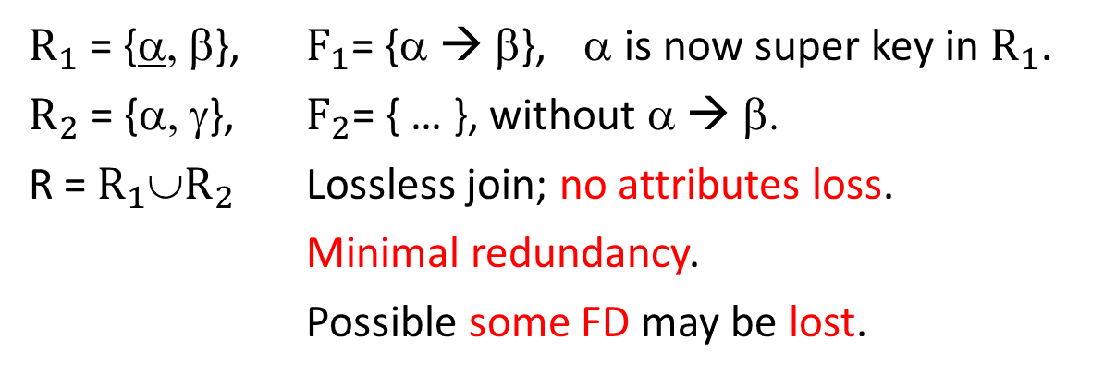

Slide 3 BCNF
R
α | β | γ
R = {α, β, γ}, F = {α → β, …}
If α is not a super key in R, we decompose R and F.
$R_{1}$
$R_{2}$
$R_{1}$ = {α, β}, $F_{1}$= {α → β}, α is now super key in $R_{1}$.
$R_{2}$ = {α, γ}, $F_{2}$= { … }, without α → β.
R = $R_{1}$∪$R_{2}$ Lossless join; no attributes loss.
Minimal redundancy.
Possible some FD may be lost.
α | β
α | γ
U
Alternative to BCNF: Third Normal Form

Slide 5
Third Normal Form
First Normal Form – Domain of all attributes are atomic (Lecture 8).
Cannot reduce any further.
Second Normal Form – Not used in practice (see book 7.3).
Slide 4
For BCNF, ∀ α→β, at least one of conditions 1 and 2 is true.
For 3NF, ∀ α→β, at least one of conditions 1, 2 and 3 is true.
Slide 5
E.g. from the end of Lecture 10, Pros and Cons of BCNF
In BCNF, we don’t preserve JK → L
Don’t need to decompose R because it’s in 3NF.
3rd condition: don’t need to decompose α→β if β is already determined by some candidate key.

Slide 6
Slide 6
We allow some redundancies in 3NF.
That’s the price we pay for preserving FD’s.
Slide 7
We get a canonical cover for F⁺ by removing all extraneous (unneeded) attributes from F.
More in Slide 10 ff.

Slide 7
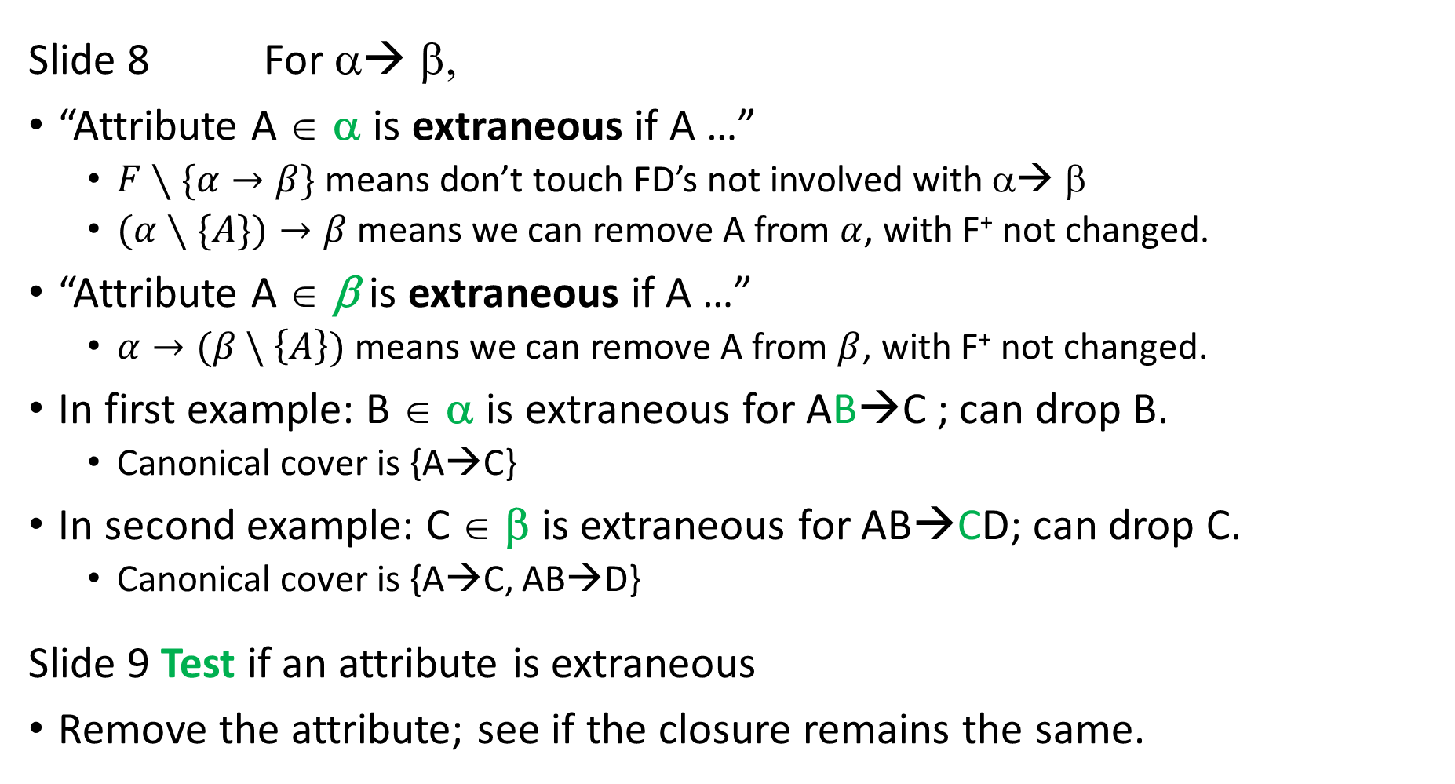
Slide 8 For α◊ β,
“Attribute A ∈ α is extraneous if A …”
$F∖\{α→β\}$ means don’t touch FD’s not involved with α◊ β
$(α∖\{A\})→β$ means we can remove A from $α$, with F⁺ not changed.
“Attribute A ∈ β is extraneous if A …”
$α→(β \backslash \left\{A\right\})$ means we can remove A from $β$, with F⁺ not changed.
In first example: B ∈ α is extraneous for AB→C ; can drop B.
Canonical cover is {A→C}
In second example: C ∈ β is extraneous for AB→CD; can drop C.
Canonical cover is {A→C, AB→D}
Slide 9 Test if an attribute is extraneous
Remove the attribute; see if the closure remains the same.

Slide 8
Slide 10
Canonical cover F_{C} has no redundant FD’s or extraneous attributes
F_{C}⁺ = F⁺
“Logically implies” means consider the closure
Example at bottom, remove extraneous attributes or FDs to bet F_{C}
Extraeneous attributs are marked in red in the lecture PPT.
A→C is extraneous
C is extraneous in A→CD
C is extraneous in AC→D
Slide 11 Algorithm to compute canonical cover F_{C}
Use union rule to simplify
Remove extraneous attributes.

Slide 9
Slide 12 Simple example for algorithm
Book has more explanations.
Slide 13-17 More Examples, step by step
Note: 1st line has attribute F in set R; 2nd line has F as the FD set.
These two F’s are different.
First iteration
First few FDs don’t look extraneous; new attributes are used at each new FDs; until we get to ACD → B.
Second iteration
Union AC → G with AC → B to get AC → BG
(This is long.)

Slide 10
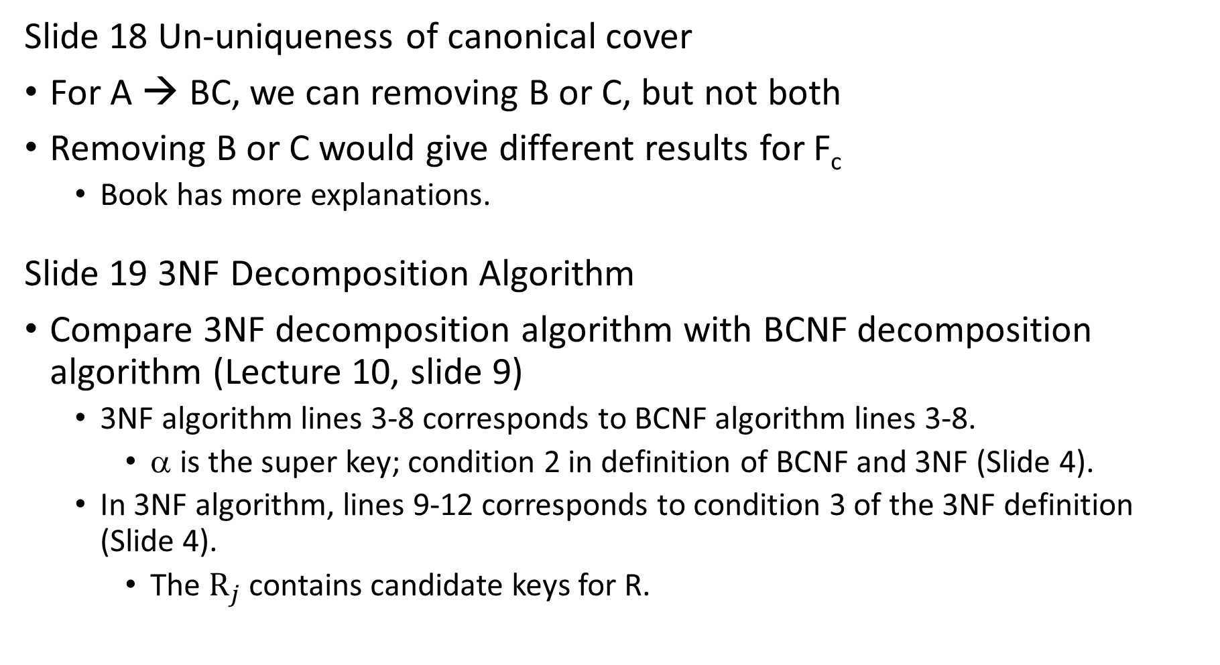
Slide 18 Un-uniqueness of canonical cover
For A → BC, we can removing B or C, but not both
Removing B or C would give different results for F_{c}
Book has more explanations.
Slide 19 3NF Decomposition Algorithm
Compare 3NF decomposition algorithm with BCNF decomposition algorithm (Lecture 10, slide 9)
3NF algorithm lines 3-8 corresponds to BCNF algorithm lines 3-8.
α is the super key; condition 2 in definition of BCNF and 3NF (Slide 4).
In 3NF algorithm, lines 9-12 corresponds to condition 3 of the 3NF definition (Slide 4).
The $R_{j}$ contains candidate keys for R.

Slide 11
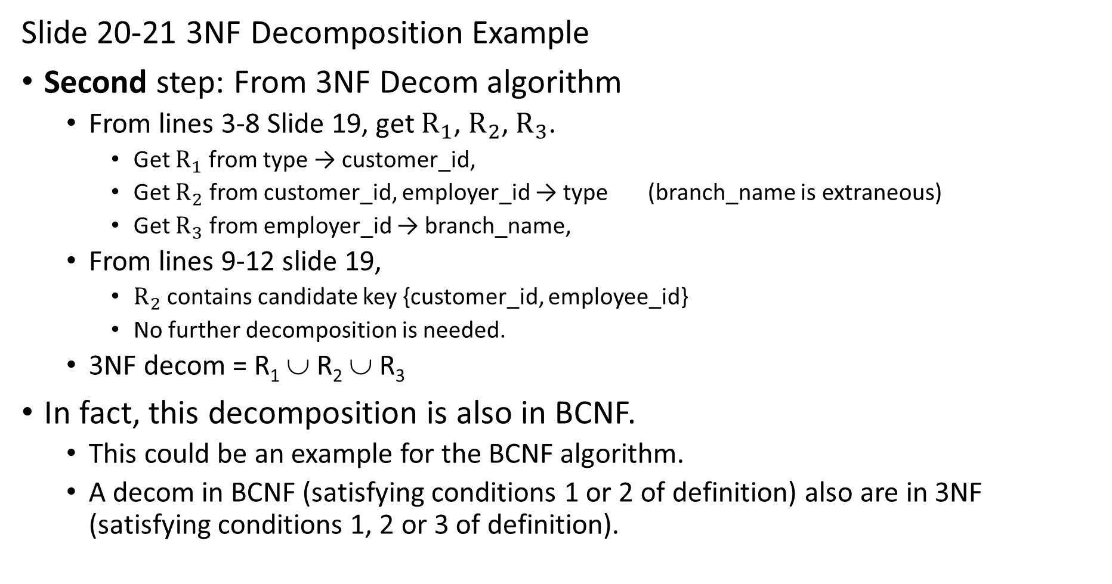
Slide 20-21 3NF Decomposition Example
Second step: From 3NF Decom algorithm
From lines 3-8 Slide 19, get $R_{1}$, $R_{2}$, $R_{3}$.
Get $R_{1}$ from type → customer_id,
Get $R_{2}$ from customer_id, employer_id → type (branch_name is extraneous)
Get $R_{3}$ from employer_id → branch_name,
From lines 9-12 slide 19,
$R_{2}$ contains candidate key {customer_id, employee_id}
No further decomposition is needed.
3NF decom = R₁ ∪ R₂ ∪ R₃
In fact, this decomposition is also in BCNF.
This could be an example for the BCNF algorithm.
A decom in BCNF (satisfying conditions 1 or 2 of definition) also are in 3NF (satisfying conditions 1, 2 or 3 of definition).

Slide 12
Slide 22
Suppose in Step 2, we first do FD2 customer_id, employee_id → type.
Get R′₁ = {customer_id, employee_id, type}
Then we do FD1 type → customer_id
{customer_id} \ {type} = {customer_id} is in the candidate key for R; see 3rd condition in the 3NF definition, Slide 4.
So don’t need to decompose for this FD.
Then do FD3 employer_id → branch_name.
Get R′₂ = {employee_id, branch_name}
3NF decom = R′₁ ∪ R′₂
This 3NF is different than last slide, and is not in BCNF.

Slide 13
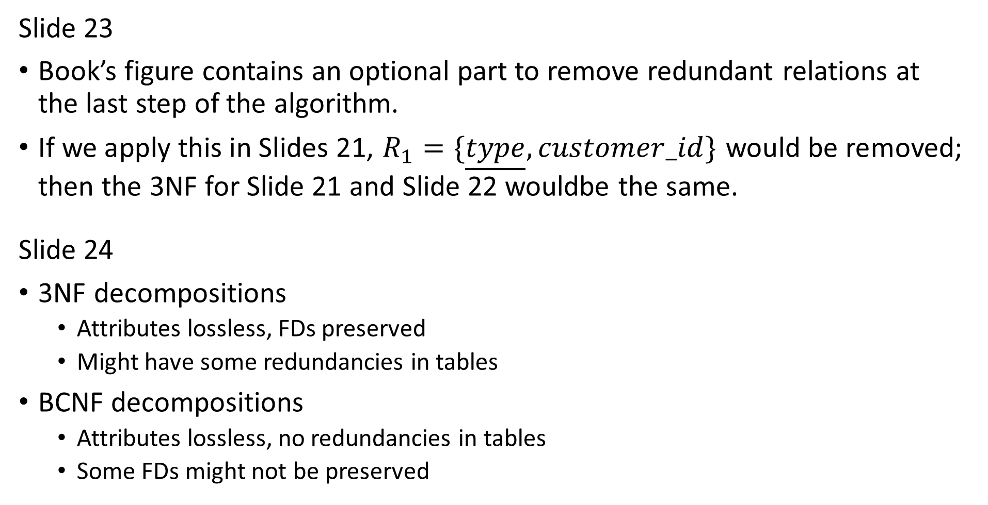
Slide 23
Book’s figure contains an optional part to remove redundant relations at the last step of the algorithm.
If we apply this in Slides 21, $R_{1}=\{\underline{type}, customer_id\}$ would be removed; then the 3NF for Slide 21 and Slide 22 wouldbe the same.
Slide 24
3NF decompositions
Attributes lossless, FDs preserved
Might have some redundancies in tables
BCNF decompositions
Attributes lossless, no redundancies in tables
Some FDs might not be preserved

Slide 14
Do intro to lab.
Remember: discuss with your team on the time slot you want to present.
Sign up during lab on Thu.

Slide 15
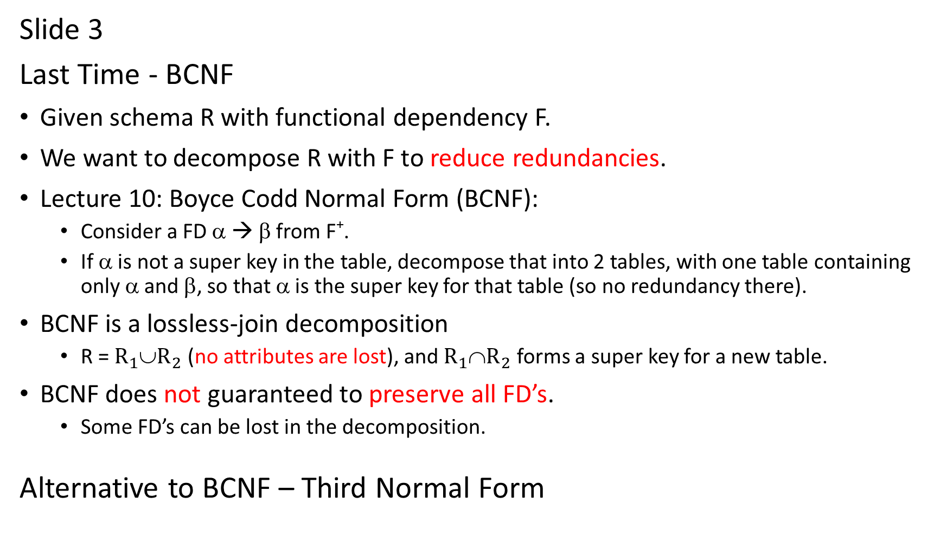
Slide 3
Last Time - BCNF
Given schema R with functional dependency F.
We want to decompose R with F to reduce redundancies.
Lecture 10: Boyce Codd Normal Form (BCNF):
Consider a FD α → β from F⁺.
If α is not a super key in the table, decompose that into 2 tables, with one table containing only α and β, so that α is the super key for that table (so no redundancy there).
BCNF is a lossless-join decomposition
R = $R_{1}$∪$R_{2}$ (no attributes are lost), and $R_{1}$∩$R_{2}$ forms a super key for a new table.
BCNF does not guaranteed to preserve all FD’s.
Some FD’s can be lost in the decomposition.
Alternative to BCNF – Third Normal Form

